Slide 1


GMR Institute Of Technology, Rajam
Department of IT
Integration of Digital Signature and ElGamal scheme for secure data Transmission in Digital Transactions
Project Supervisor P.Harisankar Narayan (19341A1284)
Mr. Y.Surya Prakash, R.Ramakrishna (19341A1295)
Asst. Professor, G.Sai Sandeep (19341A1298)
Dept. of Information Technology V.Srikara Sai Ramesh (19341A12C4)
I.Bala Raju( 20345A1207)
1
19-Jul-19
1

Slide 2
ABSTRACT
Security can be considerably a major concern when it comes to high-end data transmissions like satellite parameter communication, Defence security codes communication etc. Sensitive information of any type can leads to various attacks from intruders who is having malicious thoughts. These attacks can be significantly harmful to loss of users data (sensitive or non-sensitive data). This problem is look thoughtfully for a long time and resolved by integrating Digital Signature and ElGamal scheme(Elliptic Curve Cryptography). This Integration provides a Cognitive Feature for Authorization. The encryption is done using the standard ElGamal scheme with a well-built reputation for itself in secure data transmission. It provides a secure communication channel between the two ends by authenticating the sender with Digital Signature. One of the thrust area of this project is Digital Transactions.
Keywords: Cryptography, Elliptic Curve Cryptography, attacks, cognitive feature, Digital Signature, ElGamal.

Slide 3
PROBLEM STATEMENT
Now a days most of the people are using mobile phones for online transactions, in this case atmost 90% of transactions done through internet banking. The existing Cryptography is failed to provide security due to rendering technology hence it becomes a major concern in terms of providing security and privacy.
The above mentioned issues are overcome by integration of Digital Signature and ElGamal scheme to get the efficient security.

Slide 4
OBJECTIVES
To overcome the problems in existing system, the proposed system is promoted with an authentication process involving Digital signatures of the user in implementation. A group of points plotted on an image is provided to the user for him to use his cognitive abilities and remember the points he has selected the first time he uses the system.Coming to the process of elgamal scheme, using these selected points a private key is generated for this user. An mathematical operations are performed on the points to attain the digital signatures. With the help of the now obtained private key and a base point, a public key for this user is also generated. The other authenticated end follows suit thus far. Now, in order for them to have a connection and basically validate each other, a session key needs to be generated on either end which is required to be equal. After generating and verifying the session key, both the end users are now set to communicate with each other. A message sent by either user is then encrypted using the method of elliptic curve cryptography. Thus sent message is now decrypted and digitally signed on the receiver end.

Slide 5
EXISTING SYSTEM
In this Existing concepts Elliptic Curve Cryptography plays a significant role in improving the integrity and confidentiality of the data. In that cryptography it will not give full security to data transmission in wireless network. Wireless network get more problem during packet transmission leads to loss of data so we can’t able prevent these kind of problems using this algorithms .
Drawbacks:
• Modified data easily.
• It does not provides the message authenticity.
• Dynamic Key changing was very slow.

Slide 6
LITERATURE SURVEY – 1
[1].H. N. Almajed and A. S. Almogren, "SE-Enc: A Secure and Efficient Encoding Scheme Using Elliptic Curve Cryptography," in IEEE Access, vol. 7, pp. 175865-175878, 2019, doi: 10.1109/ACCESS.2019.2957943
Elliptic Curve Cryptography (ECC) is a public-key cryptosystems, which is based on the algebraic structures of the elliptic curves over finite fields and Elliptic Curve Discrete Logarithm Problem (ECDLP). The ECC is updated version of the RSA cryptosystem, because ECC uses smaller keys and signatures than RSA for the same level of security and provides very fast key generation and fast key agreement. ECC digital signature algorithms like ECDSA (for classical curves) and EdDSA (for twisted Edwards curves).
ECC follows Point multiplication. In point multiplication a point P on the elliptic curve is multiplied with a scalar k using elliptic curve equation to obtain another point Q on the same elliptic curve. i.e. kP=Q

Slide 7
Point multiplication is achieved by two basic elliptic curve operations:
Point addition, adding two points J and K to obtain another point L, i.e (L = J + K)
Point doubling, adding a point J to itself to obtain another point L, i.e (L = 2J)
The SE-Enc scheme consists of nine phases:
generating system parameters
encoding the message
mapping to the elliptic curve
encrypting the mapped points
signing the encrypted message
verifying the received message
decrypting the message
decoding the decrypted message
Converting the decoded message into plaintext.

Slide 8
Advantages:
It is simply stronger and secure than many cryptography technique.
It uses less key size compared to RSA algorithm.
Resistant to several encryption attacks.
Disadvantages:
Significantly more complex mathematical computations.
A relatively large group of weak elliptic curves.
It produces high length cipher text more than RSA encryption.

Slide 9
LITERATURE SURVEY – 2
[2].Islam, SK Hafizul, and G. P. Biswas."Provably secure and pairing-free certificateless digital signature scheme using elliptic curve cryptography." International Journal of Computer Mathematics 90.11 (2013): 2244-2258.
This algorithm takes master secret key, identity of user and the systems parameter as input and returns the identity-based private key of the user. In order to obtain the partial private key, the user ID sends to the PKI from which the user can validate his private key.
In attack model of the CL-DS scheme, the stronger security notion of a CL-DS scheme is against the adaptive chosen message and identity attacks which means that an adversary chooses any message randomly from the message space and then asks the signer to sign the message.
The CL-PKC scheme has received much attention of many researches as it eliminates the certificate management problems occurring in traditional PKI.

Slide 10
Advantages:
The digital signature is one of the basic tools used in public key cryptography (PKC)/public key infrastructure (PKI) in order to accomplish the message integrity, authenticity and non-repudiation when the messages are exchanged over any public channel.
The Security and computation cost comparisons of this signature scheme with other existing schemes prove to be secured and efficient.
Disadvantages:
The digital signature schemes based on PKI need complex public key certificate management process in order to authenticate the public key, which decreases the applicability in real environments.
The identity information no longer forms the entire public key in CL-PKC scheme.

Slide 11
LITERATURE SURVEY – 3
[3]. Y. Luo, X. Ouyang, J. Liu and L. Cao, "An Image Encryption Method Based on Elliptic Curve Elgamal Encryption and Chaotic Systems," in IEEE Access, vol. 7, pp. 38507-38522, 2019, doi: 10.1109/ACCESS.2019.2906052.
Cryptosystems are mainly divided into two categories which are symmetric and asymmetric encryptions, in symmetric encryption the encryption key is same as decryption key. The asymmetric encryption requires that the encryption key should be different from the decryption key, and the decryption key cannot be calculated from the encryption key. Two different types of keys namely the public key and the private key are required in asymmetric encryption.
Elliptic curve cryptography(ECC) is a significant asymmetric encryption technology based on elliptic curve mathematics which is the difficulty to calculate the discrete logarithms. ECC utilizes the combination of discrete chaotic map and menezes-vanstone ECC to generate the keys and parameters.

Slide 12
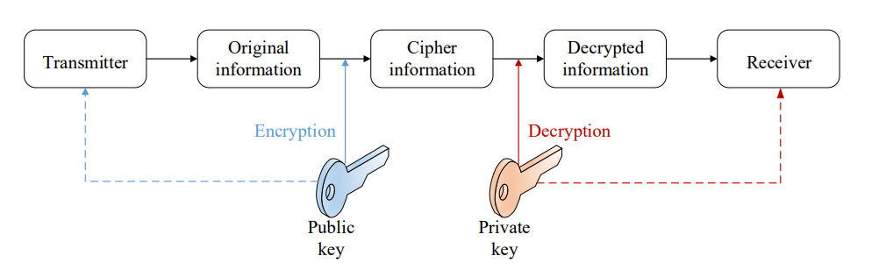
Asymmetric Encryption
Advantages:
Good efficiency
High security
Disadvantages:
High time consumption.
It does not satisfy the real time communications.

Slide 13
LITERATURE SURVEY – 4
[4]. Abitha, K. S., Anjalipandey, A., & Kaliyamurthie, D. K. P. (2015). “Secured data transmission using elliptic curve cryptography”. IJIRCCE, 3(3), I-7.
Secured data transmission using elliptic curve cryptography is based on the encryption and decryption, they are most widely used in Social media.
Security issues in transmitting data between source and destination has been the main problem in the existing system.
A new way using AODV algorithm that increases the security considerations of the network for transferring the data and using ECC, the efficiency of AODV algorithm can be incremented.
Secured data transmission using elliptic curve cryptography is based on encryption and decryption

Slide 14
The confidentiality of information and are most widely used to analyze, find the method for security of data.
A new way, that increases security considerations of the network using AODV algorithm for the transfer of data and to increment the efficiency of AODV algorithm using ECC
Advantages:
ECC has high efficiency.
Cracking ECC is very difficult as it involves complex Mathematics.
Disadvantages:
More Unreliability when compared to other algorithms
Modified data easily.
This algorithm is only used for encryption and decryption.
Windows XP don’t support ECC.

Slide 15
LIST OF MODULES
Module 1
Implementation of Encryption using ECC
Module 2
Implementation of Decryption using ECC
Module 3
Implementation of Digital Signature
Integration of ElGamal scheme and Digital Signature
Module 4

Slide 16
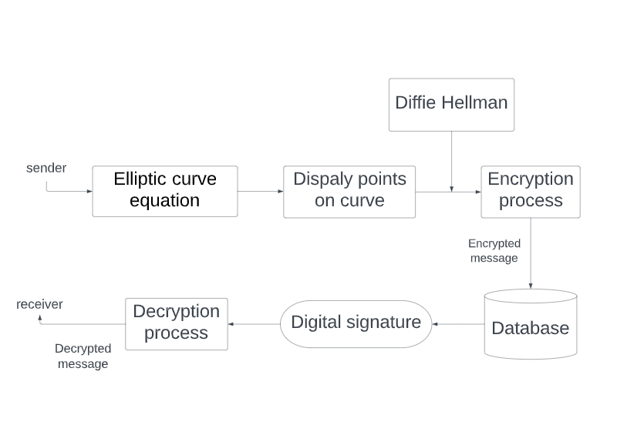
System Architecture

Slide 17
Methodology
Module 1: Implementation of Encryption using ECC
In ECC, Encryption is an asymmetric key encryption algorithm which is based on the Diffie–Hellman key exchange.
Encryption involves two steps:
key Generator:
This phase contains -
Sender generates an efficient curve from cyclic group G of order q with generator g.
Sender chooses a random value for x in (1,2,3,4,.........., q-1).
h value can be obtained by computing h = g^x.
Sender maps h with the generated curve of order q.
Sender keeps x as his secret private key and g,h,G,q are the public keys.
key Generator
Encryption Algorithm

Slide 18
Encryption Algorithm:
The encryption algorithm works to encrypt a message m with sender’s public key.
Receiver chooses a random value for y in (1,2,3,4,.........., q-1) and then computes c1=g^y.
Receiver calculates the shared secret s=h^y.
Receiver converts his secret message m, into an element m' of G.
Receiver calculates c2=m'*s.
Receiver sends the ciphertext (c1,c2)=(g^y, m'h^y)=(g^y, m'(g^x)^y), to sender.
It is easy to find h^y, if one knows m'. Therefore, a new y is generated for every message to improve security. Due to this, y is known as ephemeral key.

Slide 19
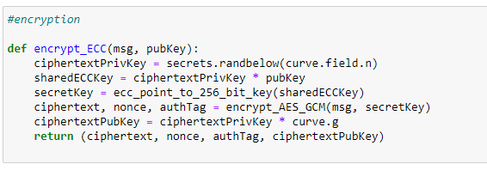
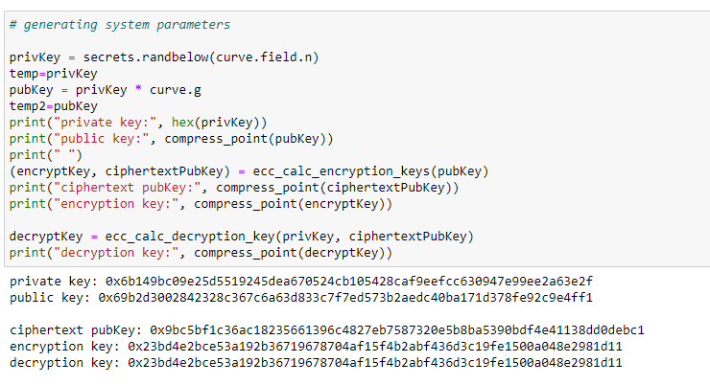

Slide 20
Flask Application
To create flask application we need to initialize the Flask object and then we root each URL followed by it’s corresponding function to that URL. Every routed function must return the displayable content on the web page. This system consists of following URLs :
Root ( ‘/’ )
encrypted data ( ‘/encrypt)
input for RSA ( ‘/rsa’ )
Keys and encrypted data ( ‘/rsaa’ )
Root ( / ) : This will be the base URL that is opened directly when we open the web server (locahost). On this page Index.html template is rendered. This consists of basic interface with keys used and the textarea to enter the text. This page will have submit button which is an hyperlink for another page. If we submit data through that form then the POST request will be sent.

Slide 21
/encrypt:
This function is responsible for calling encrypt_ECC and decrypt_ECC and to print the encrypted data. At the end this function will render the index.html with the back button. On this page ECC encryption.html template is rendered
/rsa:
On this page RSA.html template is rendered. This consists of basic interface with textarea to enter the text. This page will have submit button which is an hyperlink for another page.
/rsaa:
This URL call the function that is responsible for RSA encrytpion and finally render the results.html page.

Slide 22
Running application :
The Flask application is started by calling the run() function. The method should be restarted manually for any change in the code. To overcome this, the debug support is enabled so as to t

Slide 23
Module 2: Implementation of Decryption using ECC
The cipher text which is generated after encryption is decrypted in this module using ECC
The conversion of cipher text into plain text is known as Decryption.
The decryption algorithm works as follows:
By using private key x we decrypt the cipher text(c1,c2)
Sender calculates the shared secret key s=c1^x, and then computes m'=c2*(s^(-1)).
Then converts back into the plaintext message m, where 1/s is the inverse of s in the group G.
The decryption algorithm produces the intended message, since
c2(s^(-1)) = m'h^y(g^{xy})^(-1) = m'g^{xy}g^{-xy} = m'

Slide 24
Module 3: Implementation of Digital signature Algorithm
Digital signature algorithm is used for verification of message comes from valid sender or not, for example consider communication between A and B.
Message is authenticated by signing A using own private key.
B verifies the message sent by A or not by using the public key of the A.
This Digital signature algorithm is implemented by the Elliptic curves hence it is known as ECDSA.
Digital Signature algorithm involves three steps:
Key generation
Signature generation
Signature verification

Slide 25
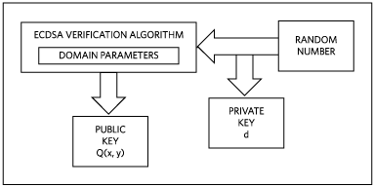
Key Generation:
Elliptic curve is represented by domain parameters set which consists of Prime Modulus p, the Prime Order n, the Coefficient a, the Coefficient b, q is a prime and the x and y coordinates of the Base Point G(x,y) on the curve.
Elliptic Curve domain parameters D= (q, FR, a, b, G, n, h).
Select a random integer d in the range of1, n- 1.
Here d is private key of A.
Compute Q = d*P.
Q is public key of A .

Slide 26
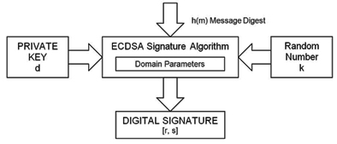
Signature generation:
Select a random integer k in range of 1, n-1.
Calculate (x1,y1)=k*G(x,y) mod p.
Calculate r = x1 mod n, if r=0 choose another value for k and recalculate r.
calculate s = (k (h(m) + d * r) mod n, If s = 0 then start the procedure from intial state.
The signature for the message m is the pair of integers (r, s).

Slide 27
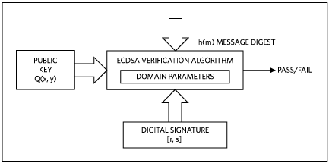
Signature verification:
The signature verification is the equivalent to the signature generation.
Calculate w = 1/s mod(n) and h(m).
Calculate u1 =h(m)w mod(n).
Calculate u2 =rw mod(n).
Calculate (x2, y2)= u1P + u2Q.
Calculate v= x0 mod(n).
If v = r the signature is verified successfully.

Slide 28
Module 4: Integration of ElGamal scheme and Digital Signature
The combination of module 1,2,3 is module 4.
In this module we execute ElGamal scheme and digital signature algorithm using python code.
The code is integrated into a single note book file to execute the Elgamal scheme and digital signature algorithm simultaneously.
No mathematical operations are involved in this module.

Slide 29
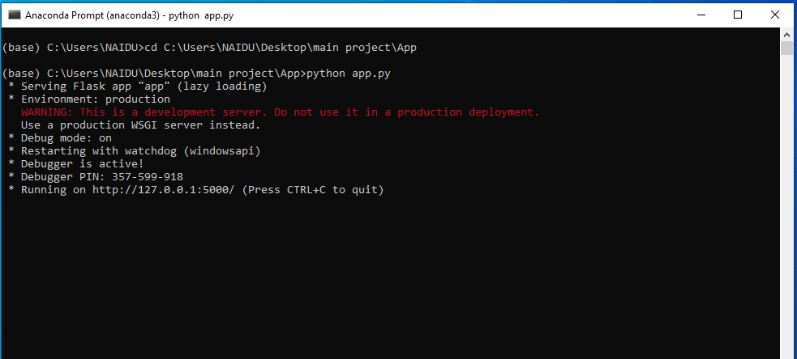
Results and discussions

Slide 30
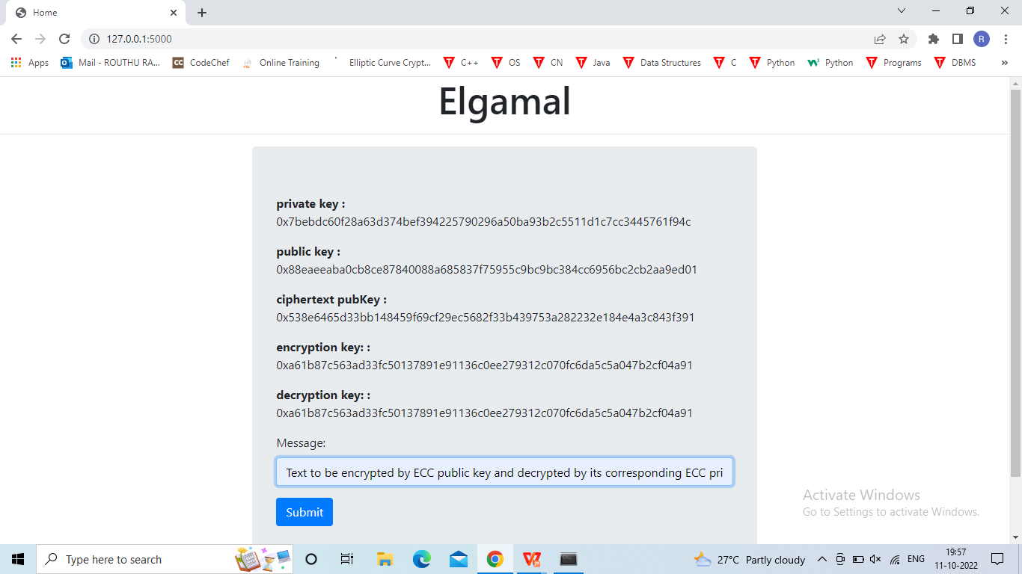

Slide 31
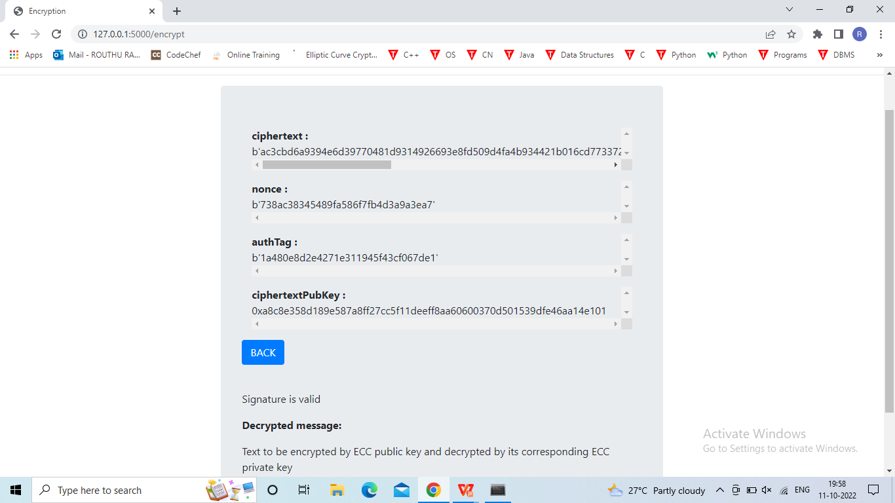

Slide 32
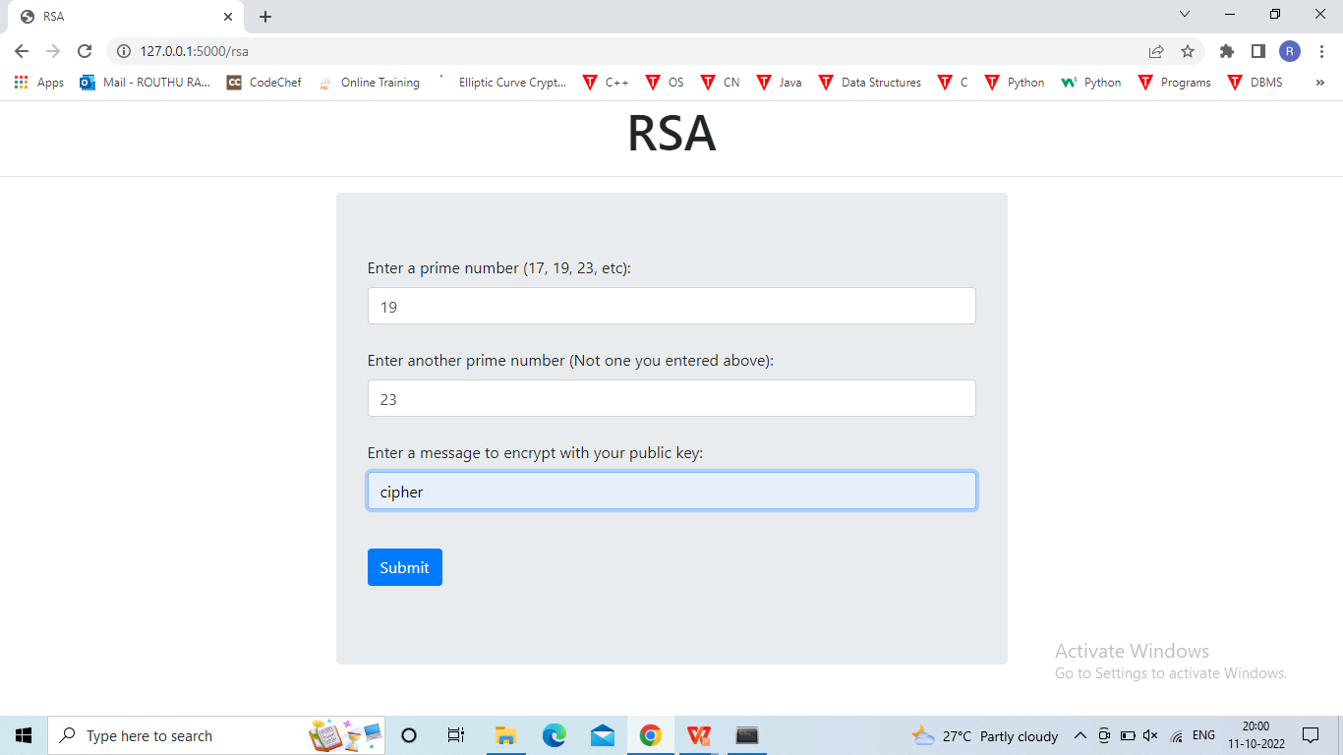

Slide 33
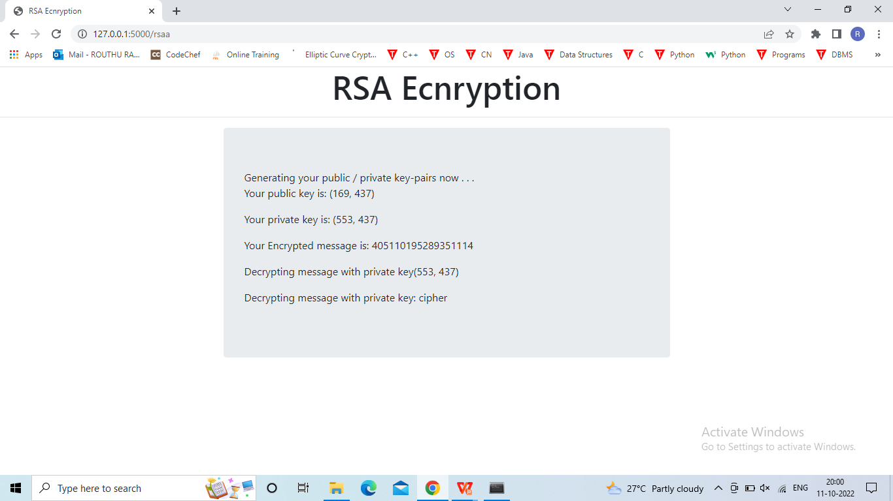

Slide 34
CONCLUSION
We have integrated ECC with digital signatures that provide high security than existing scheme. ECC provides same level security as RSA by using small keys only. This is done to make a system that is less vulnerable to different types of attacks like KPA, CPA, CCA, COA. This project ensures that the message is authenticated with the senders authenticity and verifies at the receiver’s side. The message which is also send by the sender is safely reach to the receiver without any modifications. The proposed scheme need to evaluated on different key sizes for further improvement. This needs much research on various Elliptic Curve Discrete Logarithmic Problems. A study on different curves is required to improve the efficiency.

Slide 35
REFERENCES
[1]. H. N. Almajed and A. S. Almogren, "SE-Enc: A Secure and Efficient Encoding Scheme Using Elliptic Curve Cryptography," in IEEE Access, vol. 7, pp. 175865-175878, 2019, doi: 10.1109/ACCESS.2019.2957943
[2]. Islam, SK Hafizul, and G. P. Biswas."Provably secure and pairing-free certificateless digital signature scheme using elliptic curve cryptography." International Journal of Computer Mathematics 90.11 (2013): 2244-2258.
[3].Y. Luo, X. Ouyang, J. Liu and L. Cao, "An Image Encryption Method Based on Elliptic Curve Elgamal Encryption and Chaotic Systems," in IEEE Access, vol. 7, pp. 38507-38522, 2019, doi: 10.1109/ACCESS.2019.2906052.
[4]. Abitha, K. S., Anjalipandey, A., & Kaliyamurthie, D. K. P. (2015). “Secured data transmission using elliptic curve cryptography”. IJIRCCE, 3(3), I-7.
[5]. C. Qi, "A Zero-Knowledge Proof of Digital Signature Scheme Based on the Elliptic Curve Cryptosystem," 2009 Third International Symposium on Intelligent Information Technology Application, 2009, pp. 612-615, doi: 10.1109/IITA.2009.505.

Slide 36
REFERENCES
[6]. Rajeswari, Ms PG, and K. Thilagavathi. “An Efficient Authentication Protocol Based on Elliptic Curve Cryptography for Mobile Networks.” IJCSNS 9, no. 2 (2009): 176.
[7]. Shankar, Tarun Narayan, and G. Sahoo."Cryptography with elliptic curves." International Journal of computer science and applications 2.1 (2009): 38-42.
[8]. M. A. Mehrabi, C. Doche and A. Jolfaei, "Elliptic Curve Cryptography Point Multiplication Core for Hardware Security Module," in IEEE Transactions on Computers, vol. 69, no. 11, pp. 1707-1718, 1 Nov. 2020, doi: 10.1109/TC.2020.3013266.
[9]. Qiuxia Zhang, Zhan Li and Chao Song, "The Improvement of digital signature algorithm based on elliptic curve cryptography," 2011 2nd International Conference on Artificial Intelligence, Management Science and Electronic Commerce (AIMSEC), 2011, pp. 1689-1691, doi: 10.1109/AIMSEC.2011.6010590.
[10]. S. Sciancalepore, G. Piro, G. Boggia and G. Bianchi, "Public Key Authentication and Key Agreement in IoT Devices With Minimal Airtime Consumption," in IEEE Embedded Systems Letters, vol. 9, no. 1, pp. 1-4, March 2017, doi: 10.1109/LES.2016.2630729.
.

Slide 37
Any Queries?

Slide 38


